Slide 1
TTF ML Predictions

Slide 2
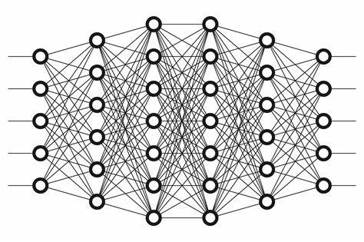
Case 1a: 1 soil
Create 500 examples with Vs ranging from 100 to 800 m/s.
Vs
TF @ freq
Freq

Slide 3
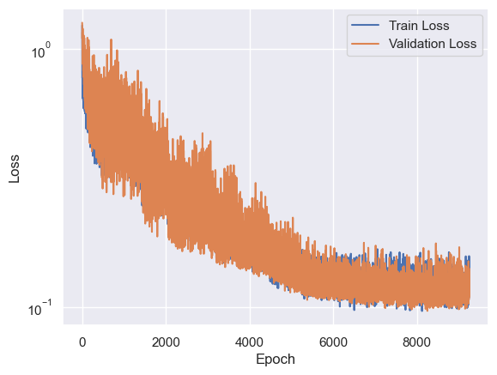
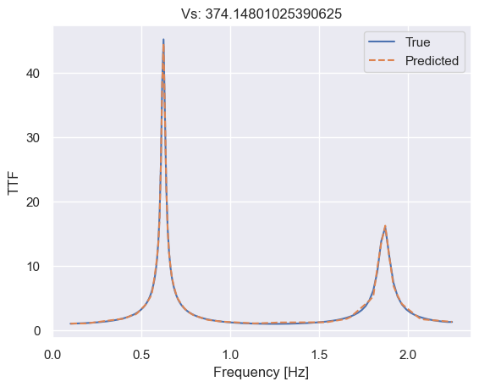
Results

Slide 4
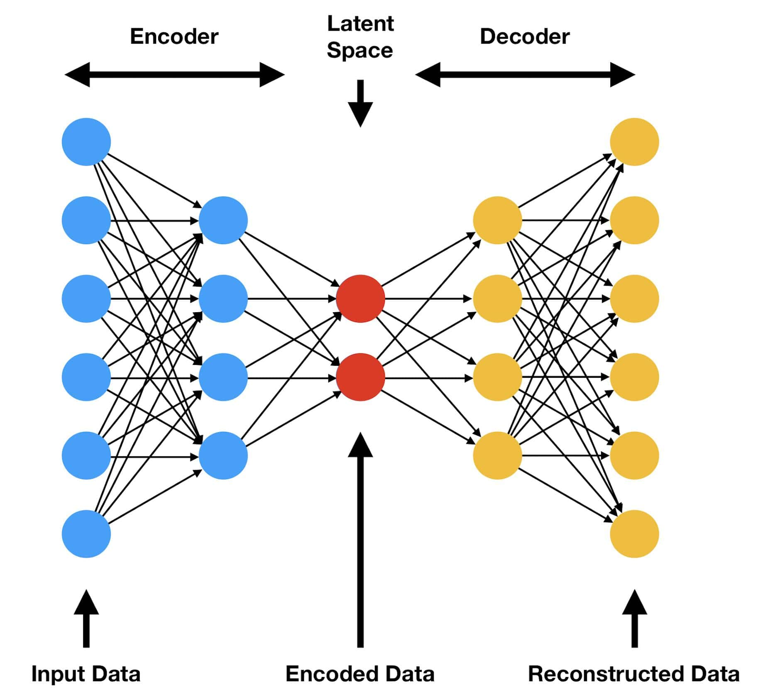
Case 1a: 1 soil
Transformer approach: Calculate the complete TF function
Vs
TTF

Slide 5
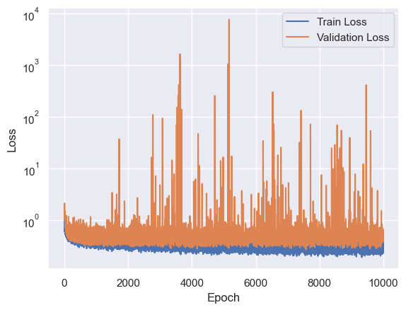
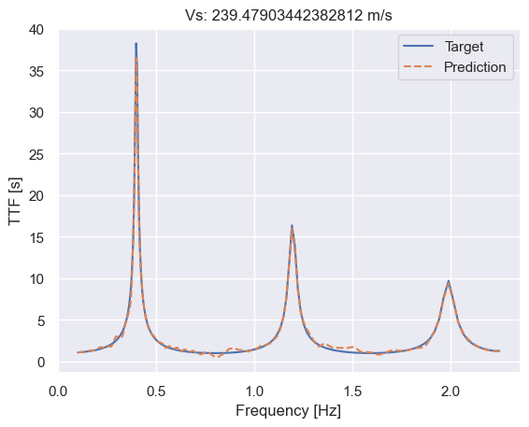
Results

Slide 6
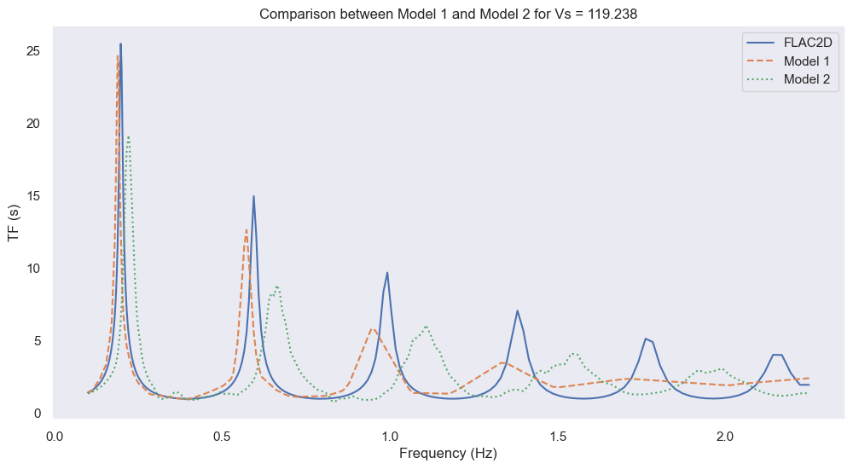
Comparison

Slide 7
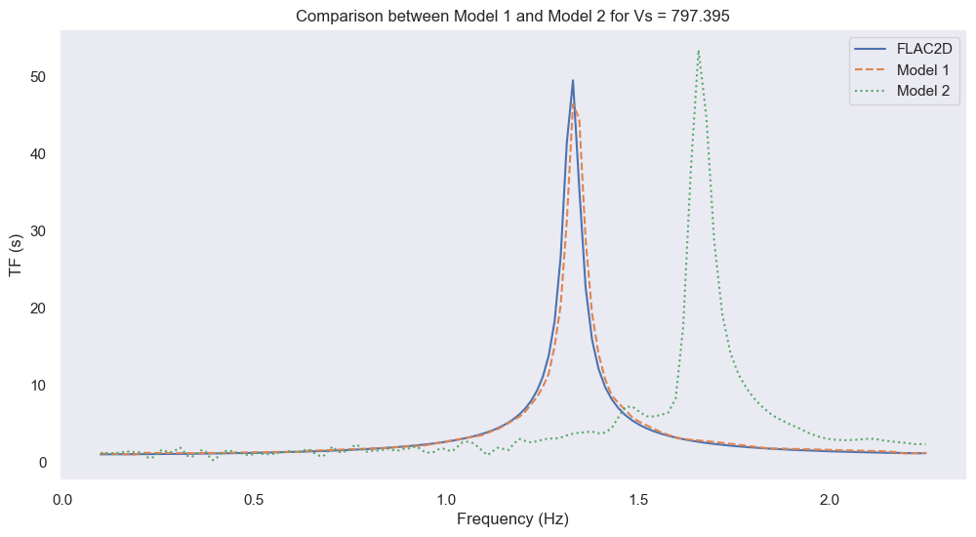
Comparison

Slide 8
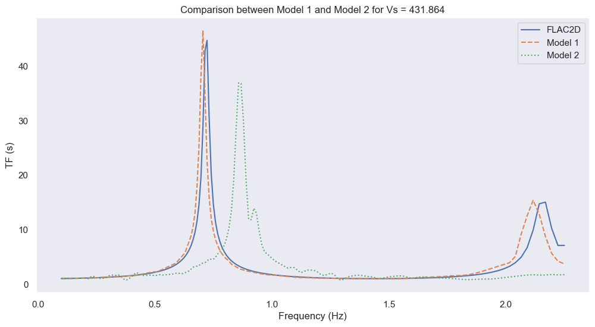
Comparison

Slide 9
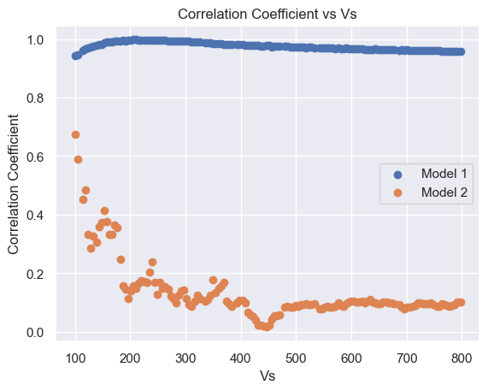
Comparison Correlation Coefficient

Slide 10
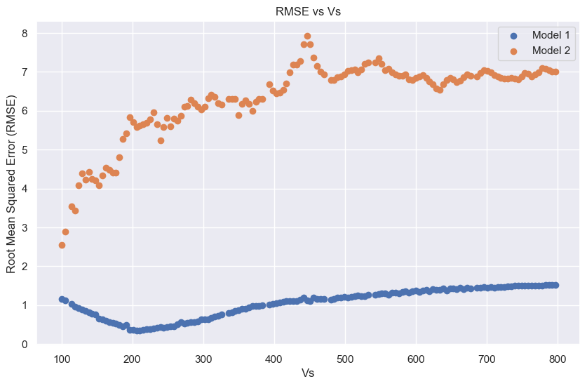
Comparison RMSE

Slide 11
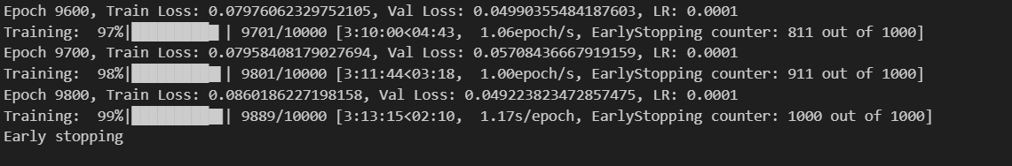
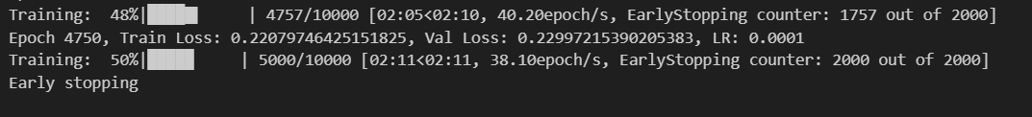
Comparison – Computational Time
Model 1
Model 2

Slide 12
Issue:

Slide 13
Approach 3: Using RNN

Slide 14
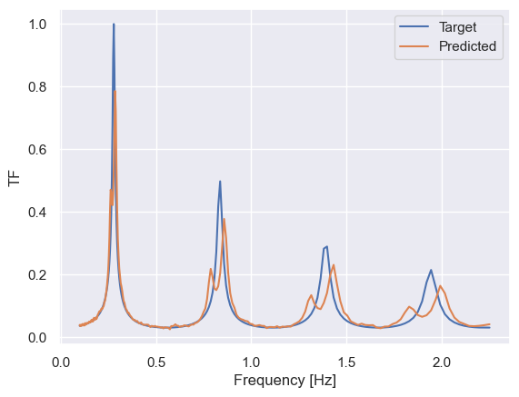
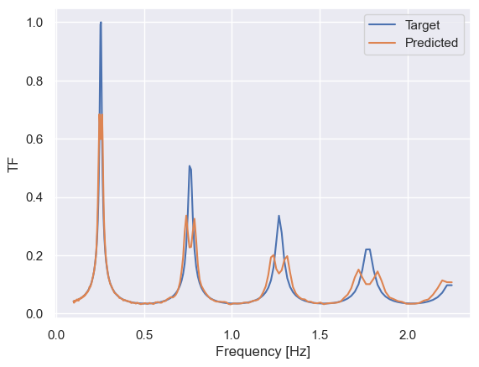
LSTM results

